Slide 1
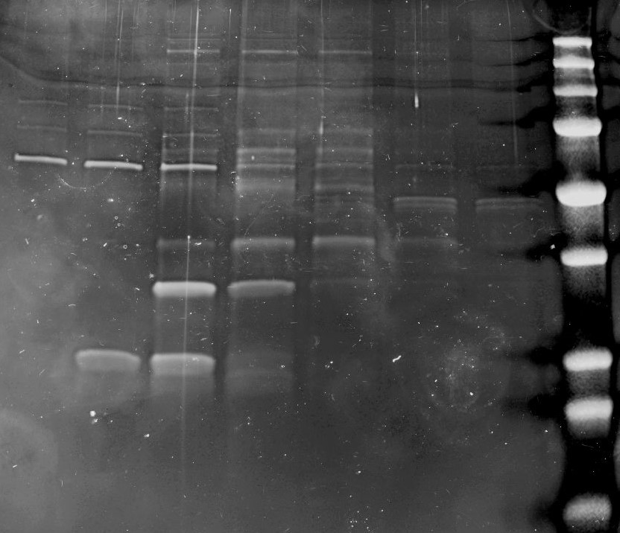
05.10.21 TFF trial : reg plasmids: hTERT-CMV, BioNoc, 6.2x10⁸ cells, 2.5mg DNA, PEI;DNA ratio- 1;1
qPCR
Ruby 2nd run
A3
A4
A5
A6
A7
A8
A9
Final (after formulation)
7.72x10¹² VGs
2D ddPCR

Slide 2
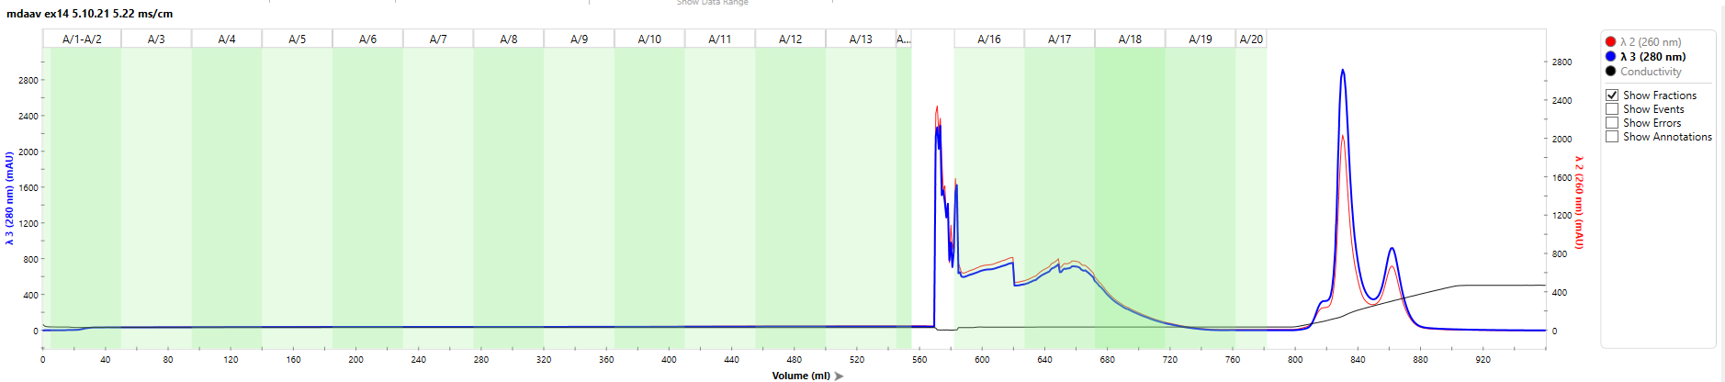
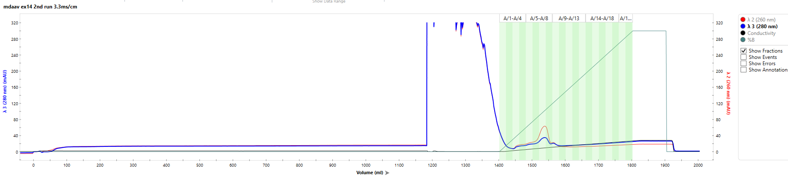
Chromatography separation
05.10.21 TFF trial : reg plasmids: hTERT-CMV, BioNoc, 6.2x10⁸ cells, 2.5mg DNA, PEI;DNA ratio- 1;1
1ST RUN
Elution
Flow-through
Wash
2ND RUN
Flow-through
Wash
Elution

